Slide 2

Assignment + Deliverables
https://github.com/JeroenBuil/deegtal_coding_task

Slide 3
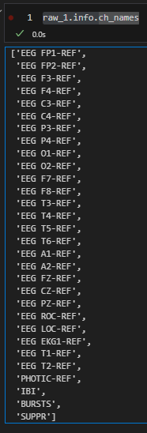
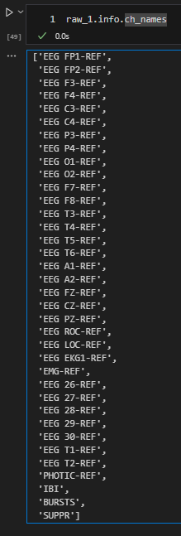
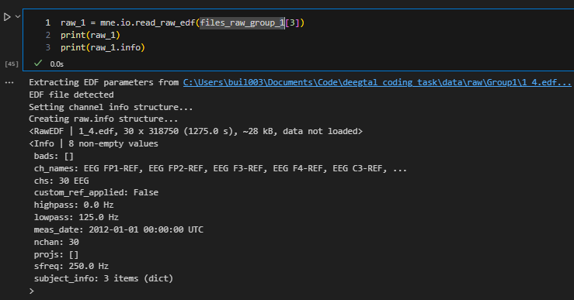
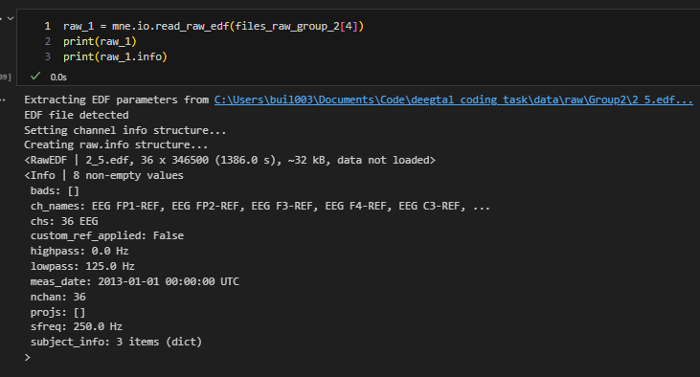
Data recorded equally?
No!
nr of channels differs between subjects
Stimuli is different
Sampling freq + filtering = equal

Slide 4
Stats
Group | Recording | Channel | Mean
1 | 1 | BURSTS | 0.339228
1 | 2 | BURSTS | 0.0
1 | 3 | BURSTS | 0.0
1 | 4 | BURSTS | 0.392392
2 | 1 | BURSTS | 0.237873
2 | 2 | BURSTS | 0.0
2 | 3 | BURSTS | 0.0
2 | 4 | BURSTS | 0.0
1 | 1 | IBI | 22.108351
1 | 2 | IBI | 0.0
1 | 3 | IBI | 0.0
1 | 4 | IBI | 10.253176
2 | 1 | IBI | 1.674255
2 | 2 | IBI | 0.0
2 | 3 | IBI | 0.0
2 | 4 | IBI | 0.0
1 | 1 | PHOTIC-REF | 0.000003
1 | 2 | PHOTIC-REF | 0.000002
1 | 3 | PHOTIC-REF | 0.0
1 | 4 | PHOTIC-REF | 0.000004
2 | 1 | PHOTIC-REF | 0.000003
2 | 2 | PHOTIC-REF | 0.0
2 | 3 | PHOTIC-REF | 0.0
2 | 4 | PHOTIC-REF | 0.0
Recording time: ~20-25min

Slide 5
Fix channel names

Slide 6
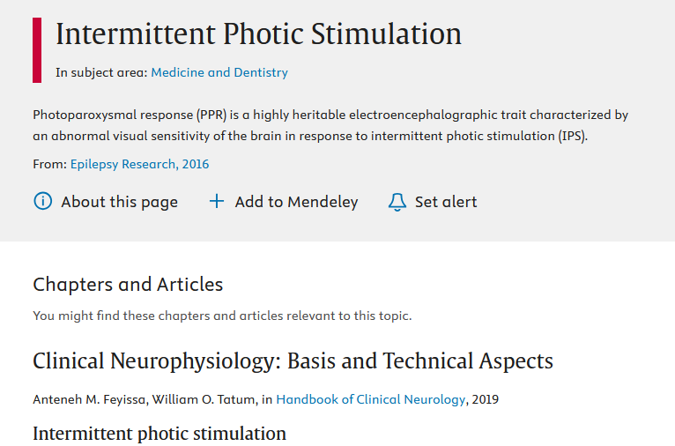
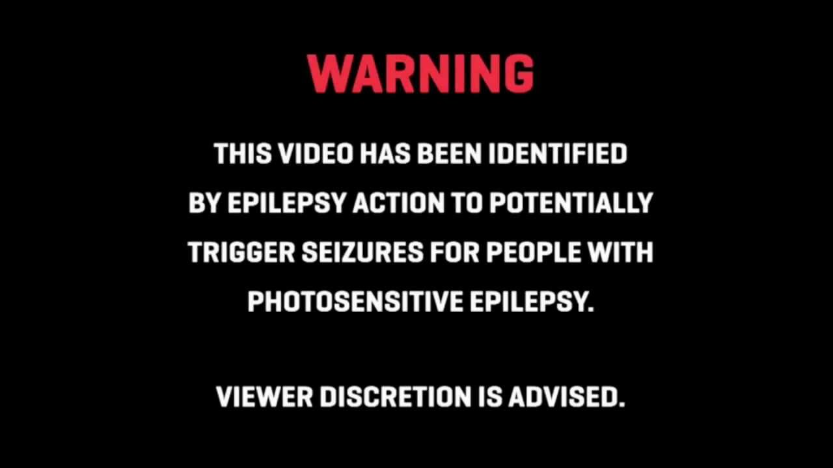
Intermittend Photic Stimulation
Pulse train
Different response epileptic vs non

Slide 7
Data conclusion
Source information + Meta data crucial for proper data analysis
Don’t know what I am looking at
Unnecessary long puzzling
Risk of false comparison between groups
No Source + Metadata == No (usable) Data

Slide 8
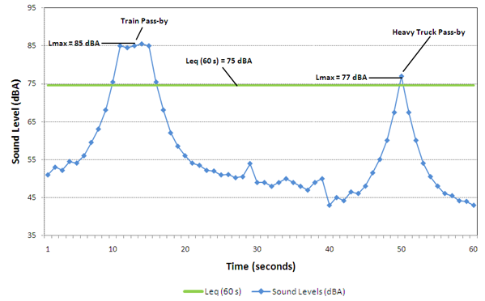
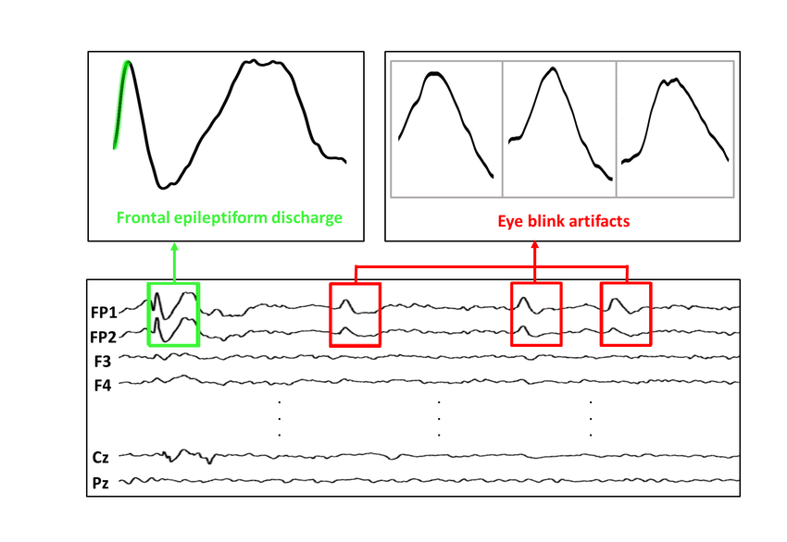
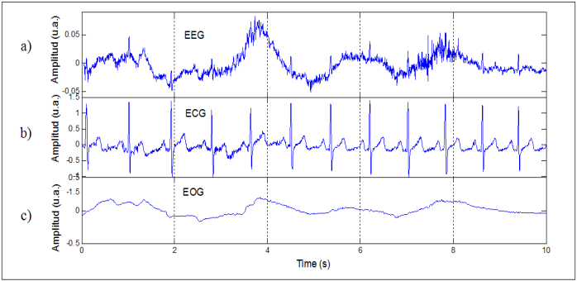
Artifacts in EEG Signals and Preprocessing
https://pmc.ncbi.nlm.nih.gov/articles/PMC861531/
Non-biological Environment
Powerline noise, traffic
=> bandpass + bandstop filtering
Biological
eye blinking, movement, respiration, and heartbeat
Often same freq range => grounding, linear regression methods
https://otc-cta.gc.ca/eng/railway_noise_measurement
A Survey on Artifacts Detection Techniques for Electro-Encephalography (EEG) Signals - Scientific Figure on ResearchGate. Available from: https://www.researchgate.net/figure/a-EEG-Signals-with-Artifacts-Caused-by-b-ECG-Signals-and-C-EMG-Signals-25_fig3_281887837 [accessed 23 Oct 2024]
Eye Blink Artifact Detection With Novel Optimized Multi-Dimensional Electroencephalogram Features - Scientific Figure on ResearchGate. Available from: https://www.researchgate.net/figure/Frontal-epileptiform-discharges-and-eye-blink-from-CHZU-database_fig1_353475354 [accessed 23 Oct 2024]

Slide 9
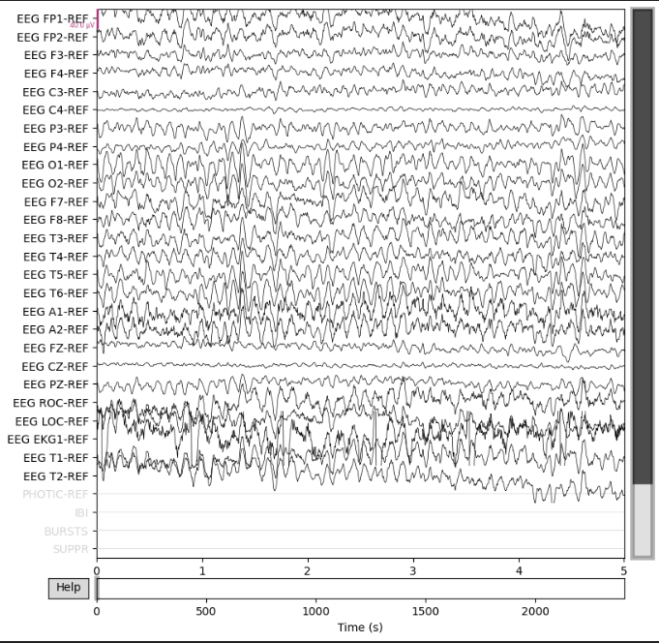
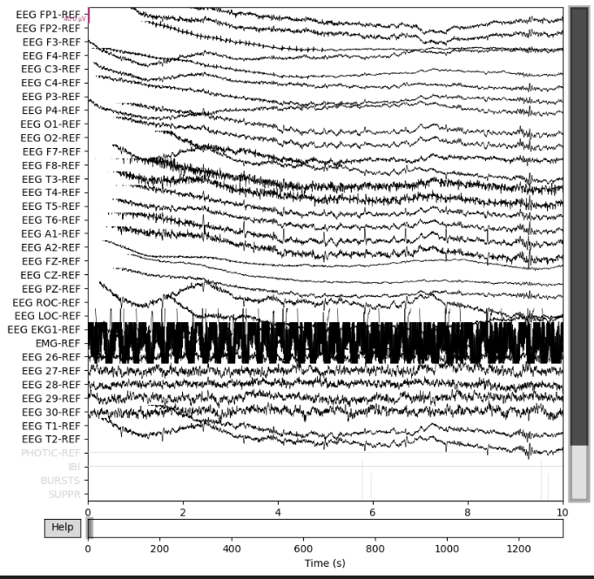
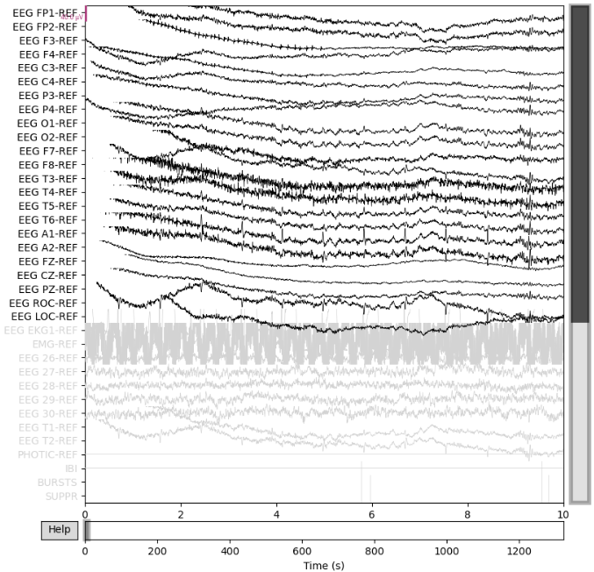

Slide 10
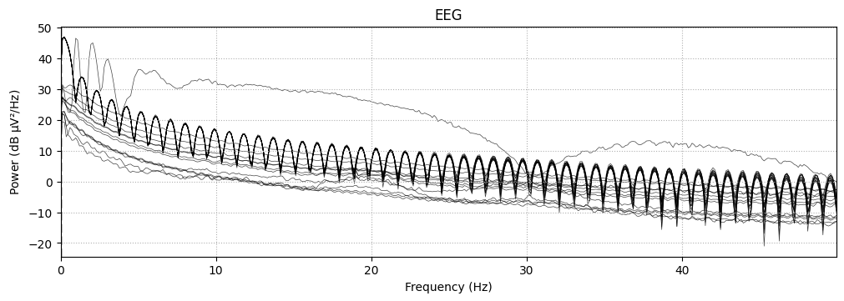
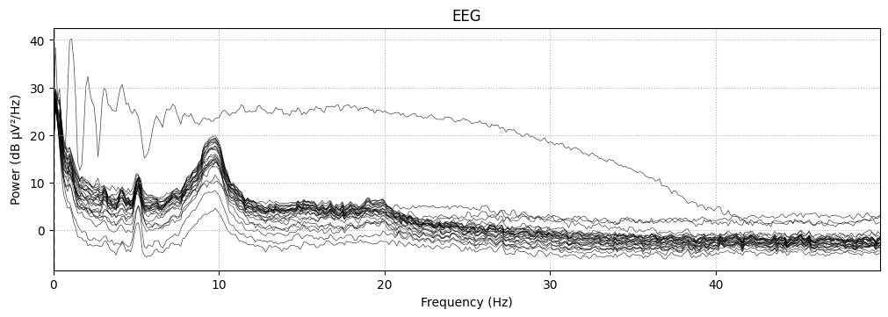
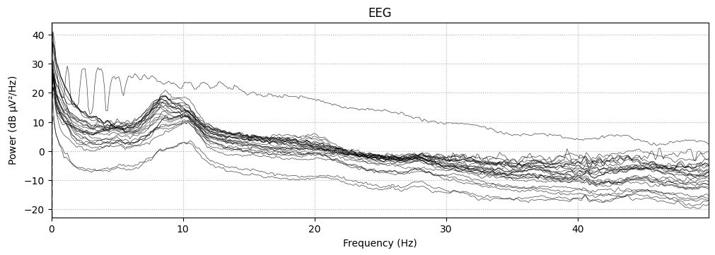
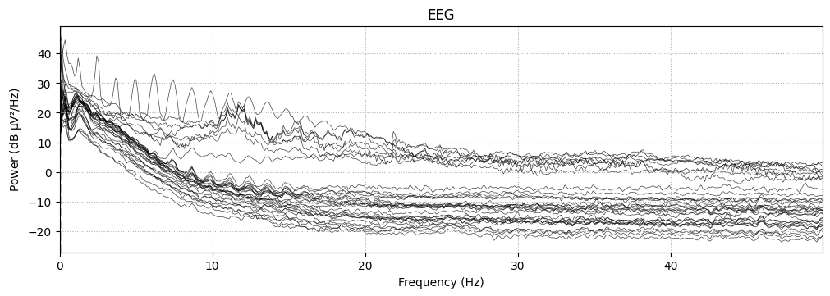
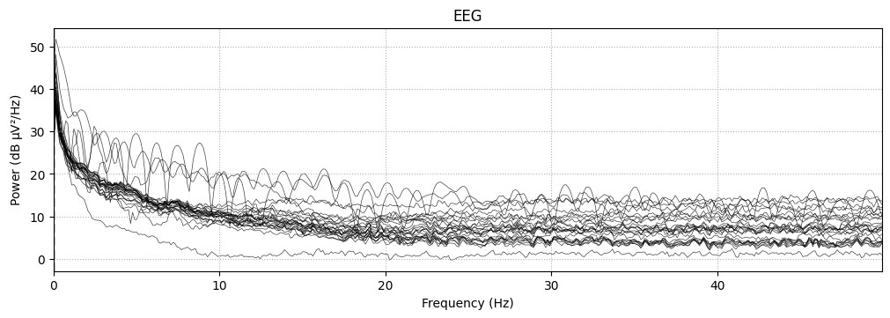
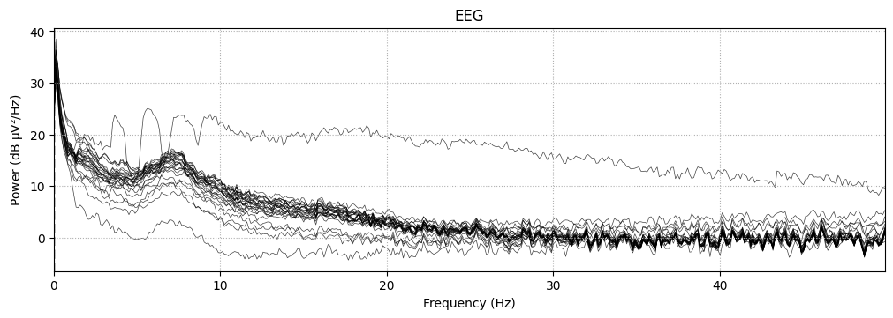
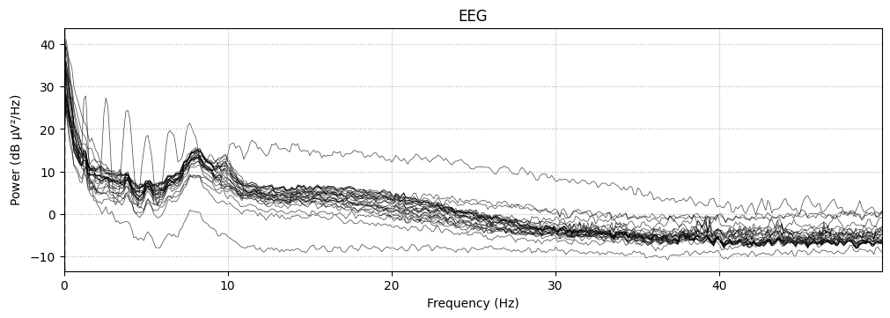
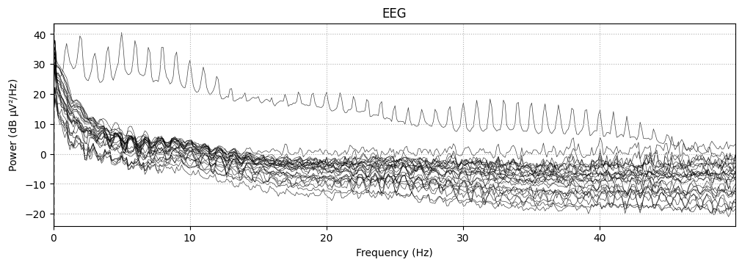
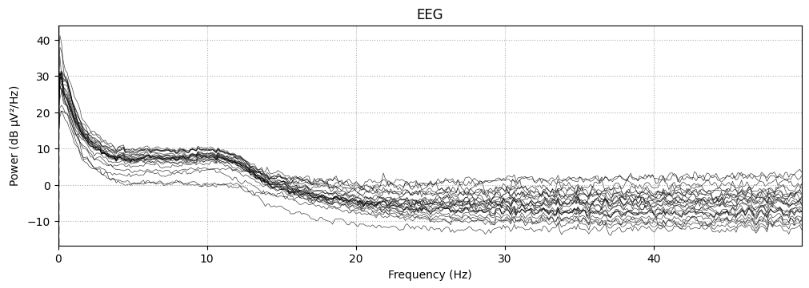
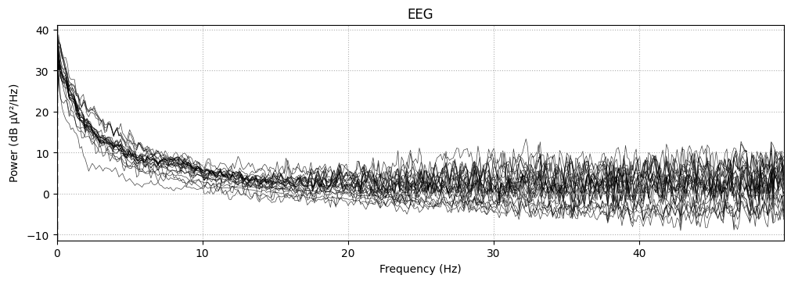

Slide 11
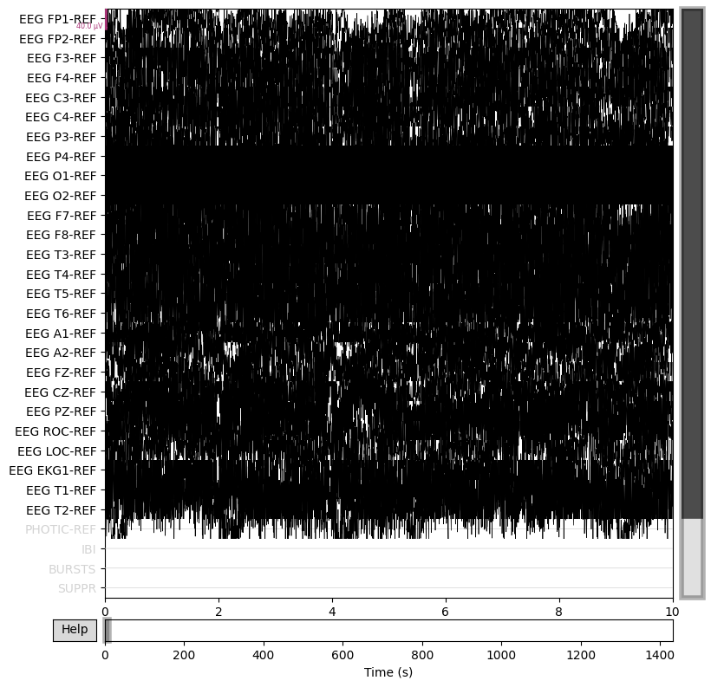
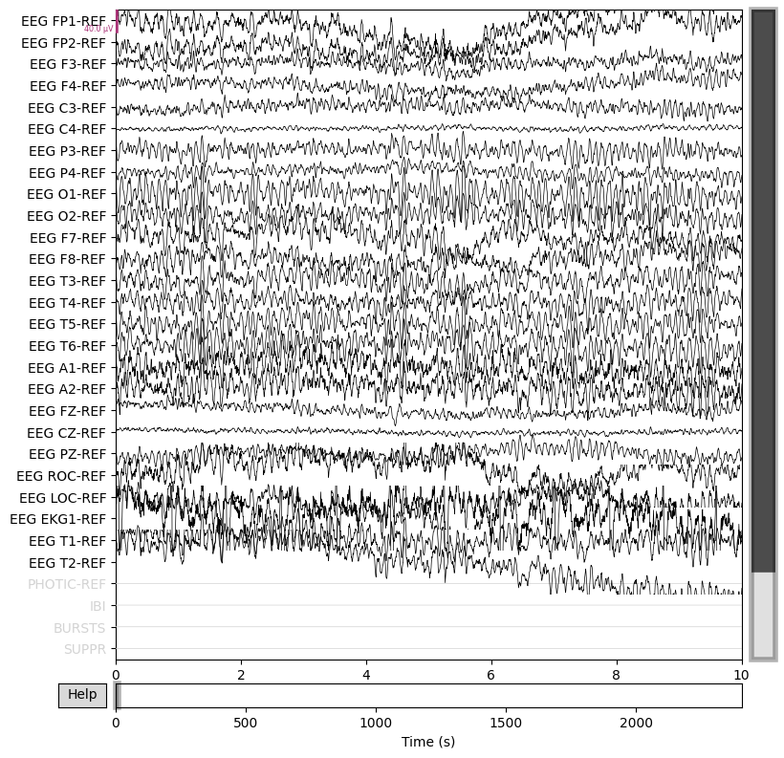
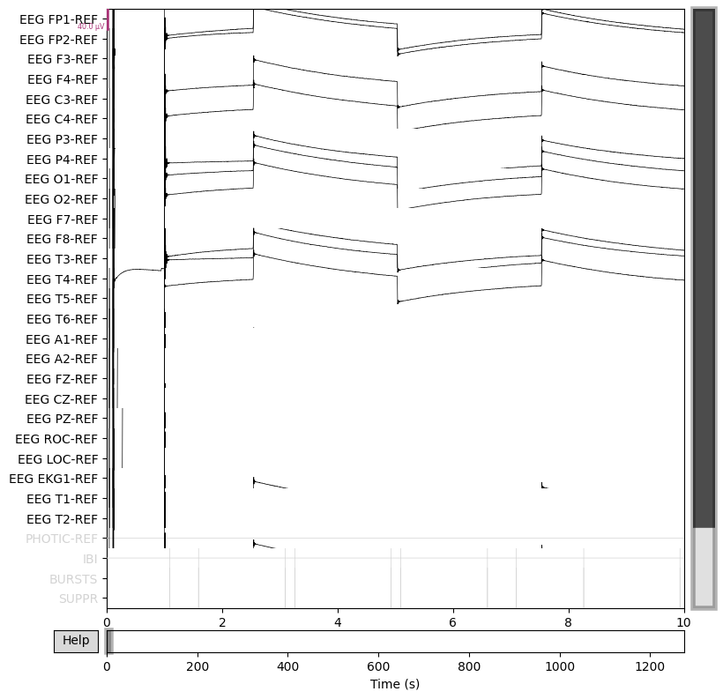
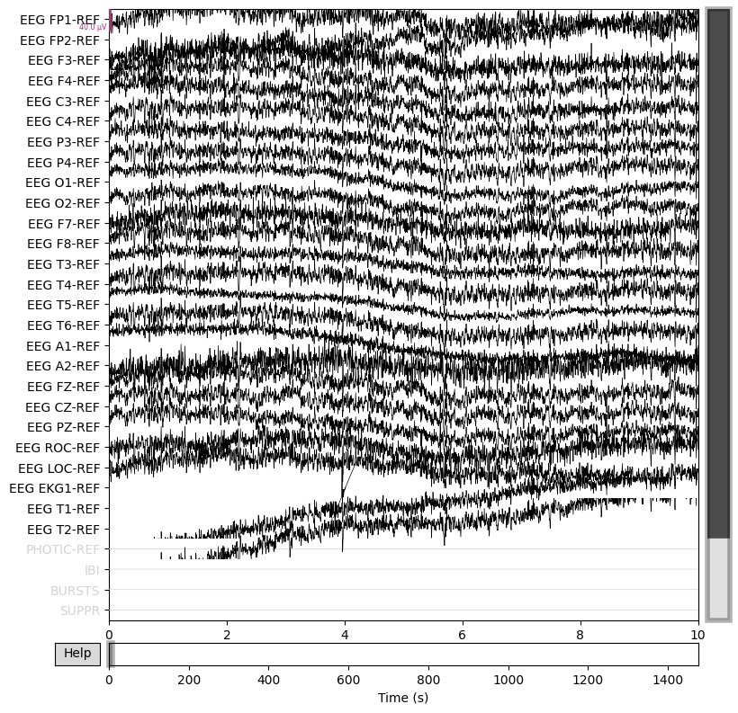
Crop start + end of recording (5min-20min)

Slide 12
Decoding
Unsupervised
+ fast, no pre knowledge, unbiased
- less info to train
Supervised
+

Slide 13
Ideal case:
Events that subjects are in same mental state + same (lack of) ext. triggers
EEG waves: 0,5-100Hz => Nyquist freq => window of at least 4s
Calc spectral density plot (spectrogram) => feature space

